Slide 1
To Know from Suter et al. (2011)
“sense-making” as illustrative of schemas
“Battleground” used to define narratives heard from others
3 main violat’s reported among these families – messages/narrtv’s they heard to reinforce those
How metaphors served to reinforce/challenge sense of family
Reply-scripts that resulted when families heard these messages

Slide 2
What is Family?
https://www.youtube.com/watch?v=PsLBEjN9mUE
Notes:
Add from Holtzmann (2008):
3 criteria used by government to define family
How way we communicate shapes and reflects understandings of family
How the 2 family def’s (traditional & socially expansive) were:
Complementing
Competing
Coexisting
How traditional norms dominated in terms of:
Marriage assumptions
Physical bond emphases (& how acknowledging its absence served to reinforce an absent bond)
Value-laden language

Slide 3
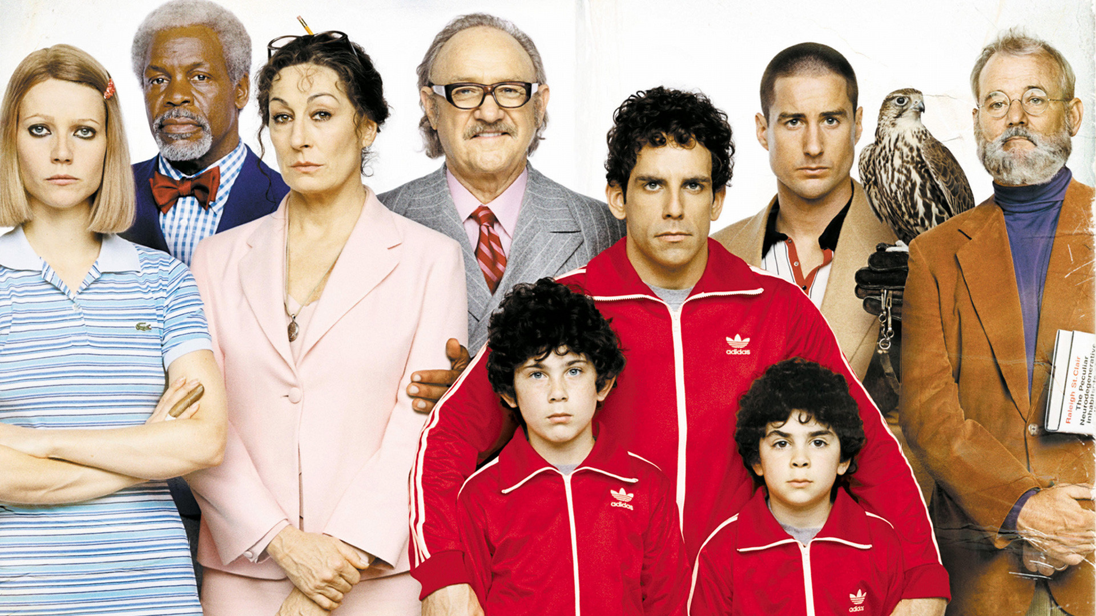
Role of Constructionism
Interactional practice → “basis for family meaning & domestic reality” (Holstein & Gubrium, 1995, p. 233)
Collective Representations

Slide 4
How we define it matters!
Affects social capital (Widmer, 2006)
Typical types of definitions (Fitzpatrick & Wamboldt, 1990)
Structural (member criteria & sex/age hierarchies)
Psychosocial (caretaking, family life tasks)
Transactional (rites, rituals shape meanings/values)
What’s associated with how we define?(Edwards & Graham, 2009)
Identity-based (blood or marital relat’s) WHO?
Expressive & Conventional comm style
Role-based (duty fulfillment) WHAT?
Conventional style
Shared-reality based (interact. practice, beliefs) HOW?
Rhetorical style
Notes:
O’Keefe (1988) maintains that the three message design logics are developmentally ordered according to functional utility. The significance of the hierarchical structure of message design logic is the ability of individuals to “focus goals and adapt language more and more finely to their service” (O’Keefe & McCornack, 1987, p. 73). The expressive premise (verbally expressing ideas) is a logical prerequisite to conventional functioning (subordinating expression to achieved desired social effects), which is a logical prerequisite to rhetorical functioning (verbally reordering social situations) (O’Keefe, 1988, p. 89).
Previous research has demonstrated that in reference to certain complex interactional tasks (e.g., conflict resolution and regulatory), the expressive, conventional, and rhetorical message design logics exist on a continuum ranging from least to most effective communication (O’Keefe,

Slide 5
Family Definition Activity!
In groups, operationalize “family”
“Horrid word, family! Its very etymology accuses it of servility and stagnation. / Latin, famulus, a servant; Oscan, Faamat, he dwells. … [T]hink what horrid images it evokes from the mind. Not only Victorian; wherever the family has been strong, it has always been an engine of tyranny. Weak members or weak neighbours: it is the mob spirit crushing genius, or overwhelming opposition by brute arithmetic.” (Crowley, 1982)

Slide 6
Family, A family, & The family
Marriage “de-institutionalized” (Allan, 2008)
Family de-centered as pers.rels. more flexible
Lay conceptions of “family” (Baxter et al., 2009)
Studied role of (a) family status linguistic term (“a family” vs. “family”) & (b) Attrib. comm quantity among members (low vs. high inaxn.freq.)
Perceptions of “family” status increased with:
Presence of children
Intactness
Family members’ co-residence
Marriage
Heterosexuality (but only in absence of children)
Non-fictive union
Attributed presence of freq. comm
Notes:
https://www.youtube.com/watch?v=9RMVIO4nmPc

Slide 7
Personal Objectives to “constructing family”
(Holstein & Gubrium, 1995)
Convey R perman./depth, estab. grounds:
Affectional
Custodial
Social capital affected by perceptions! (Widmer, 2006)
Durational
Convey apparently shared domestic life ideas (“configuration of concern” Allan, 2008, p. 235) & Assumes:
Family separate & distinct (entity in its own right)
Domestic order located w/i homes
Members have “privileged access”
Societal Objectives to constructing family

Slide 8
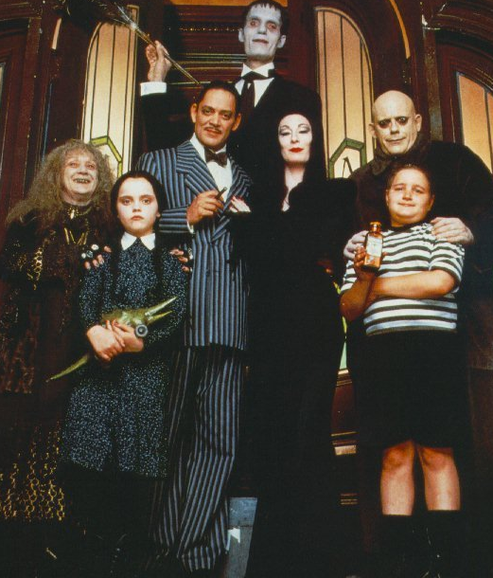
In-tact vs. Divorced
Co-residence
Nuclear (neolocality) vs. Extended (patrilocality) systems
Haven
Kinship
Fictive kin & families of choice
Foster adoption narrative study (Suter et al., 2014)
Biological normativity discourse
Discourse of constitutive kinning

